Slide 1

Private Primary School ul. Jedności Narodowej 86,
78-100 Kołobrzeg
„MORSKA KRAINA”
contact:
Tel. 94 352 53 79
Mail: szkola@morskakraina.info
Principle: mgr Dorota Żurawska-Nowak

Slide 2
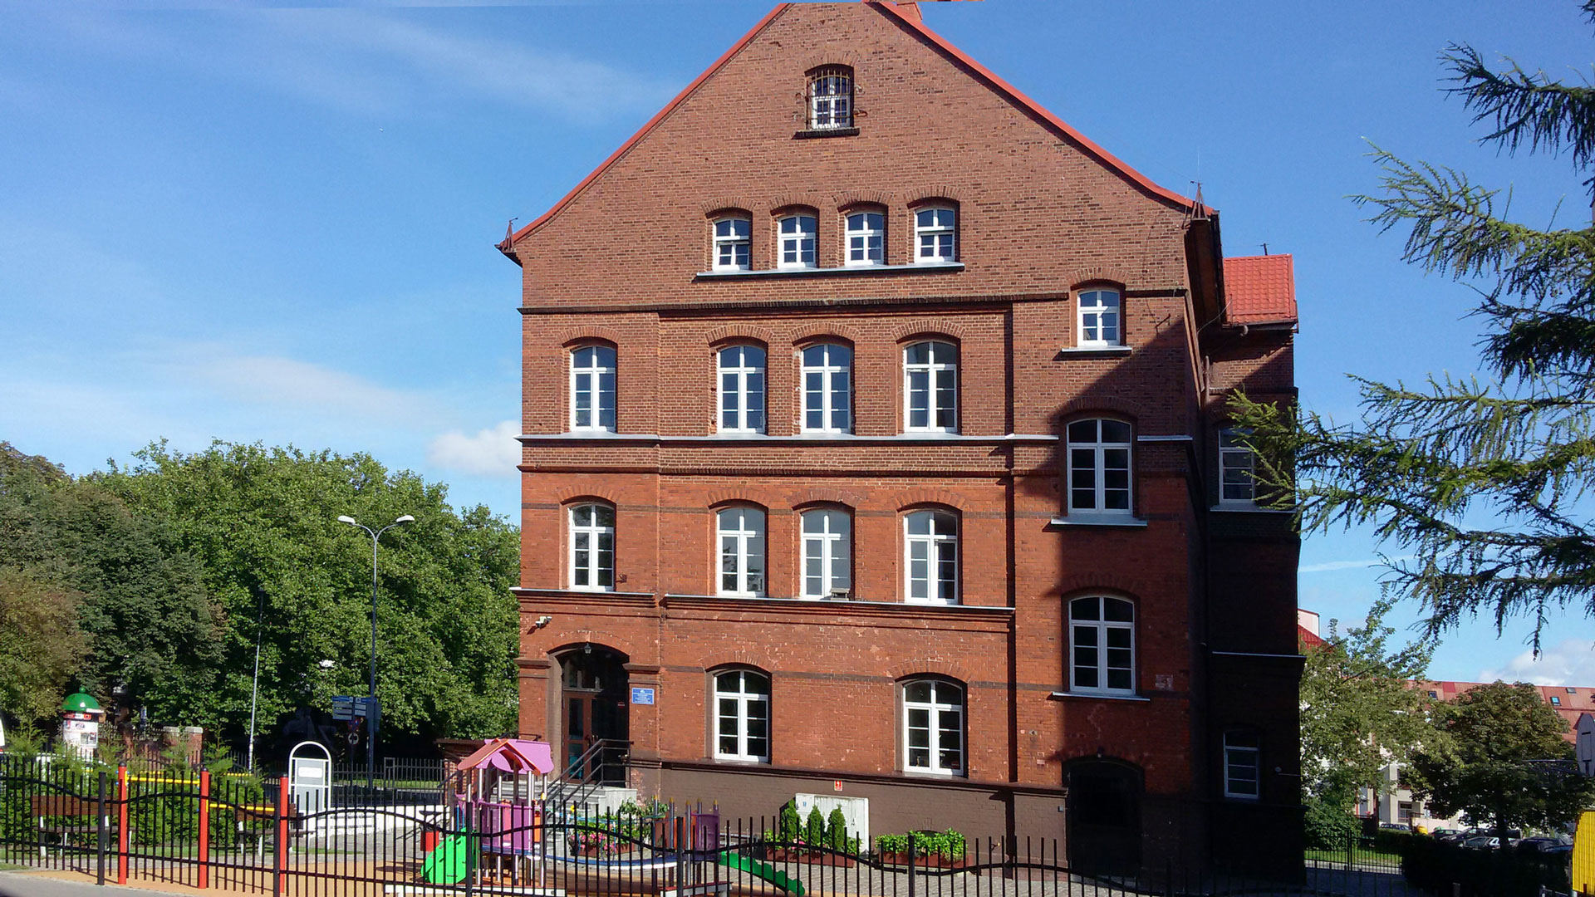
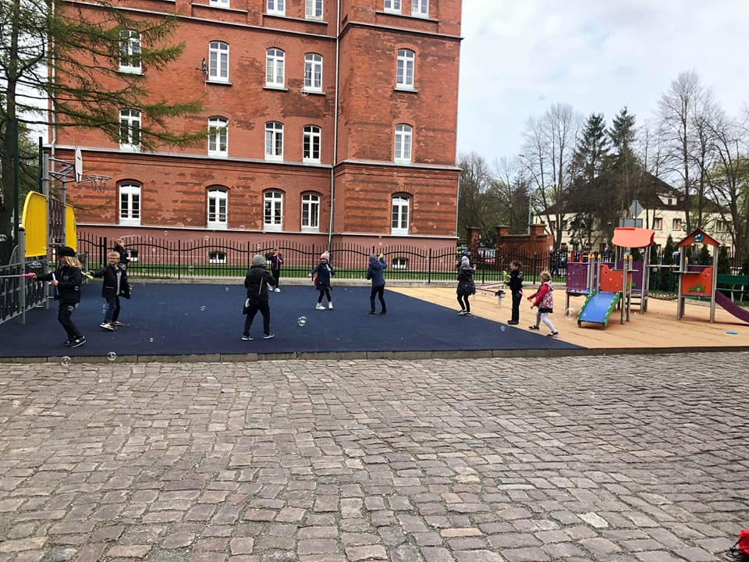
Building and surrounding
Our institution is located in two-floored building which used to be the property of Polish army (it’s made of red bricks). It’s located quite close to the city centre.
Besides the classrooms there is also an assembly room, a canteen and an adaptated attic.
A colourful playground in front of the building
A cloakroom in the basement
A common room

Slide 3
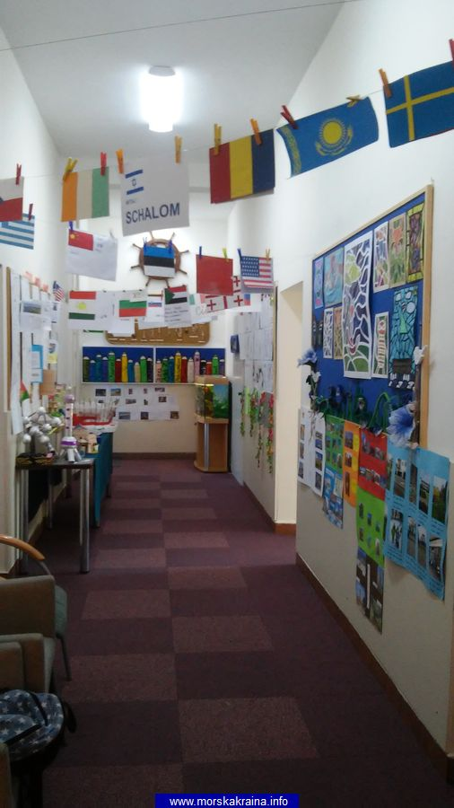
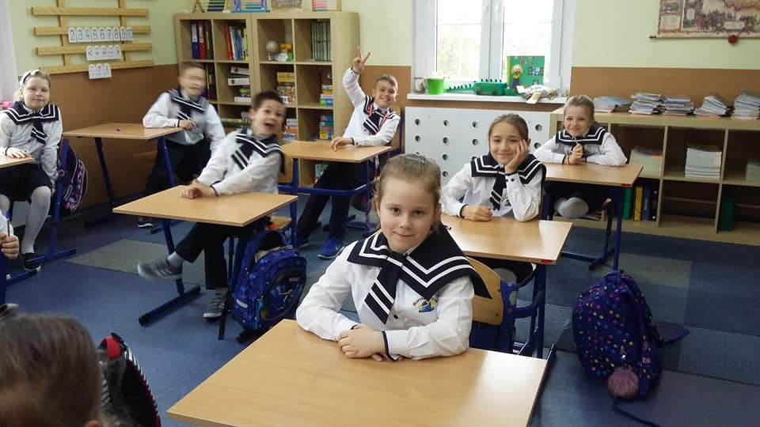
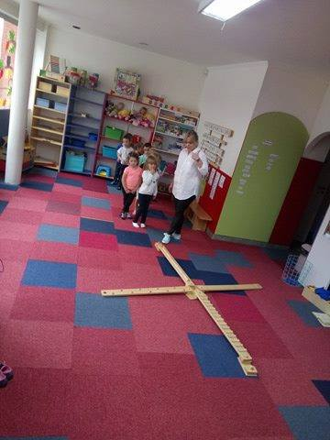
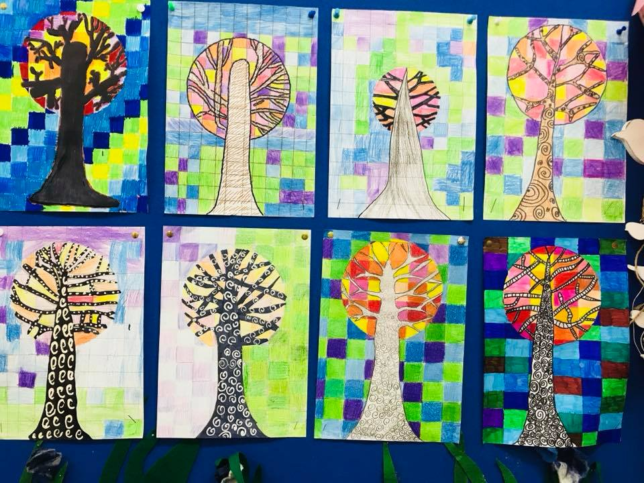
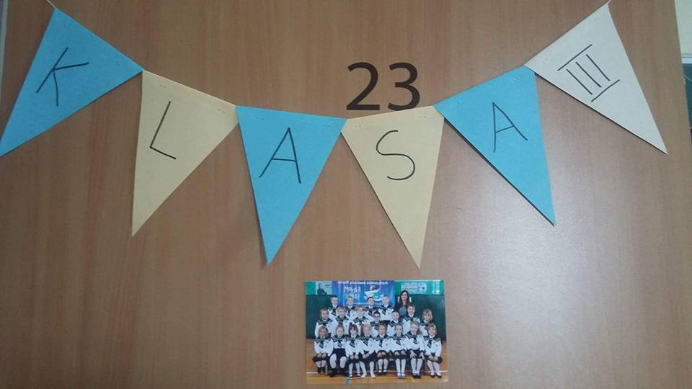
classrooms
Colourful and friendly
With space to store basic teaching aids and books (students do not take them home)
Presenting students achievements– individual and group projects

Slide 4
Our school in numbers
26 STAFF
912,1m²
THE WHOLE AREA
UP TO 22 STUDENTS IN EACH CLASS
11 CLASSROOMS

Slide 5
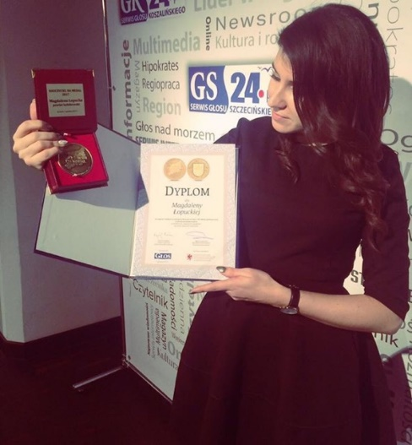
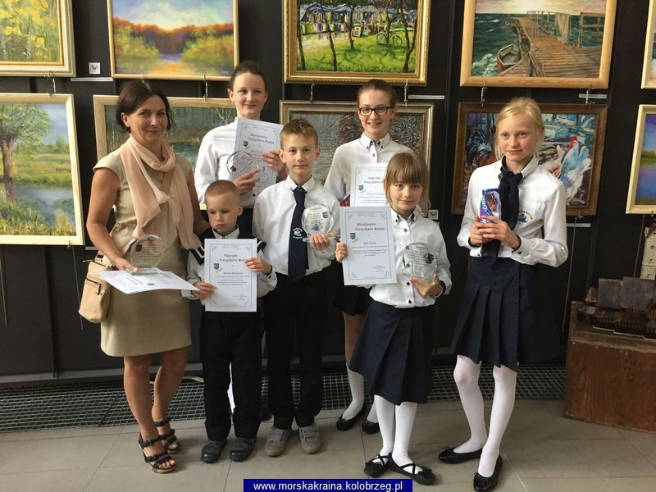
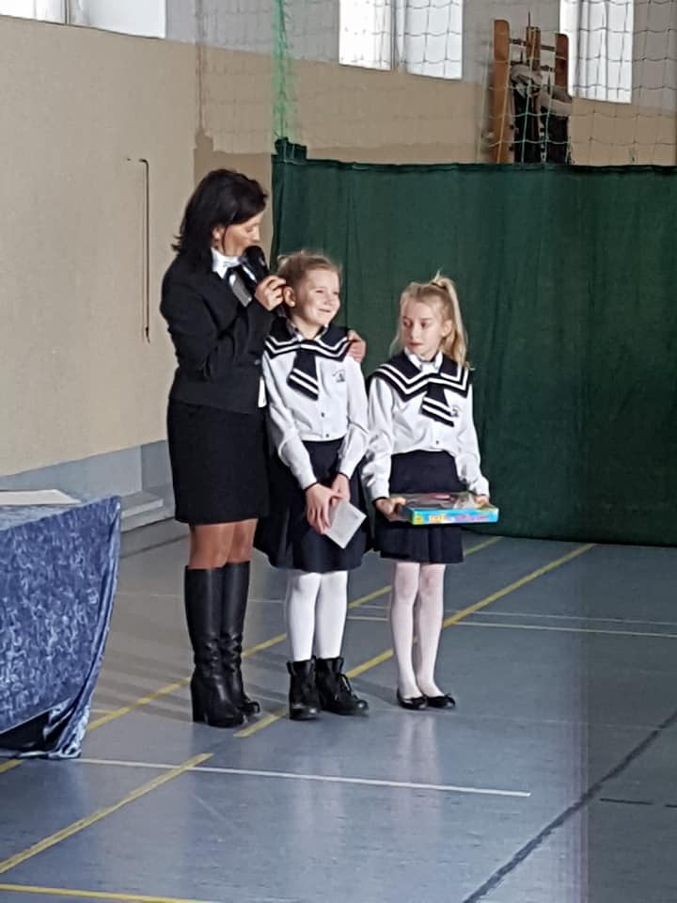
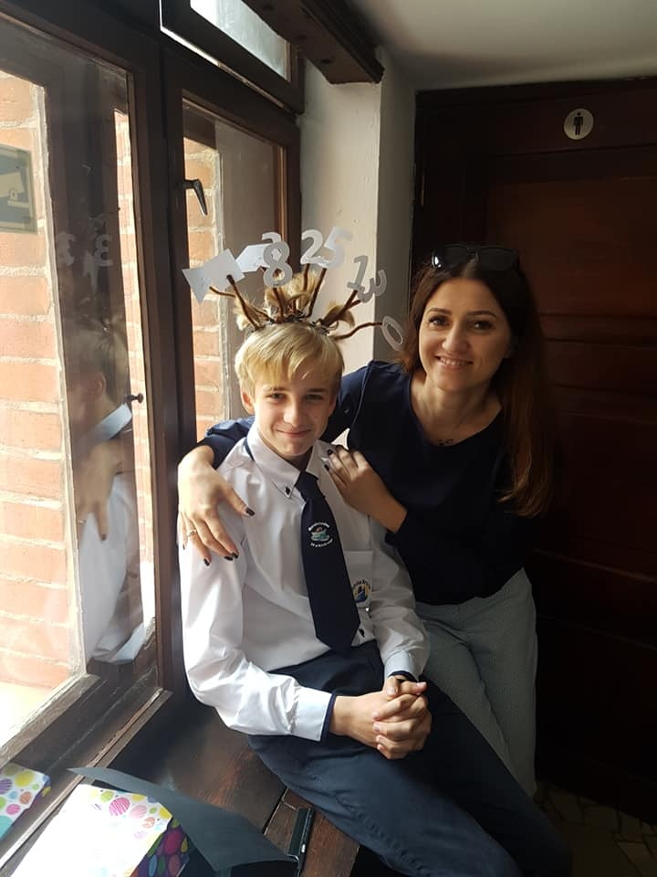
OUR TEACHERS
Our teachers are dedicated, motivated and well-qualified. They are passionate people full of positive energy, promoting respect, good manners and equality.
We appreciate their engament and permanent motivation for personal and proffesional development.
TRUST
ENGAGEMENT
SUPPORT

Slide 6
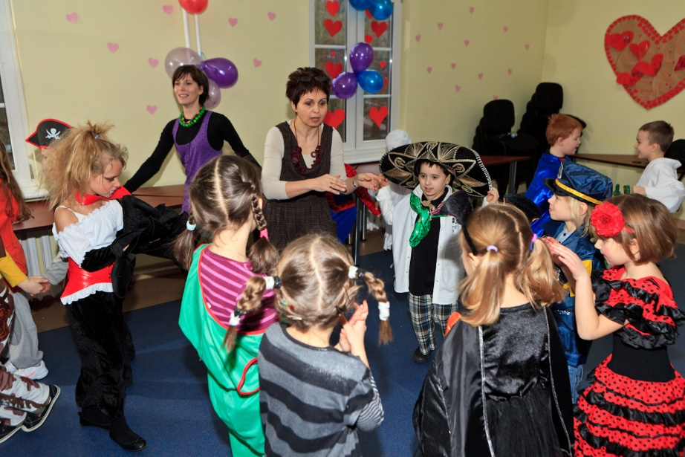
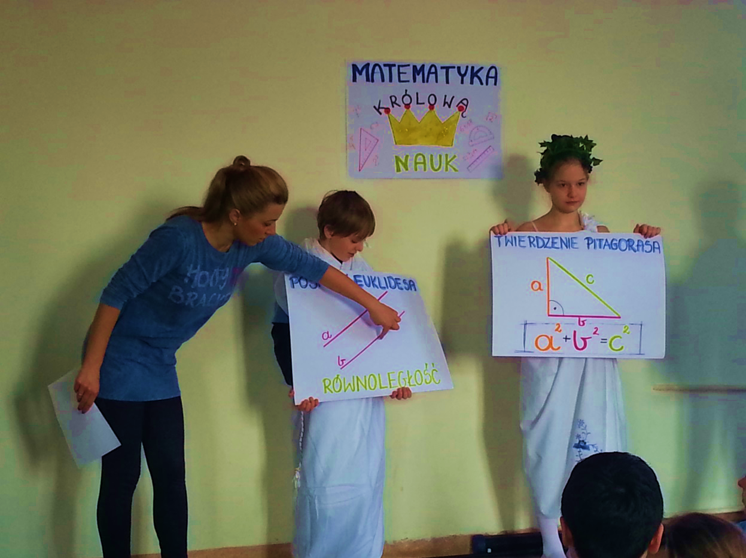
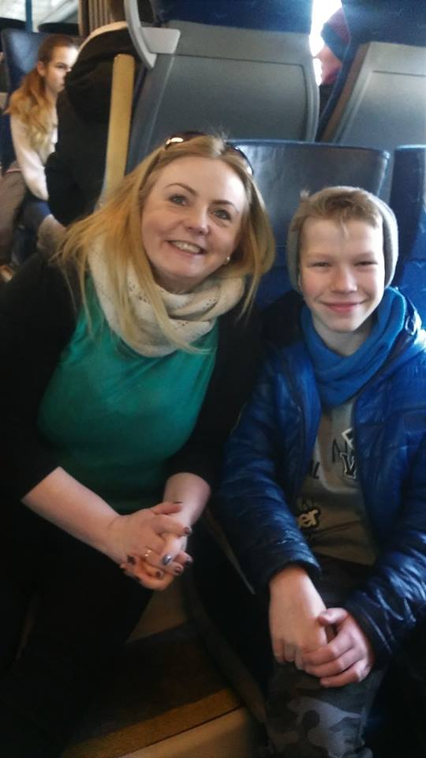
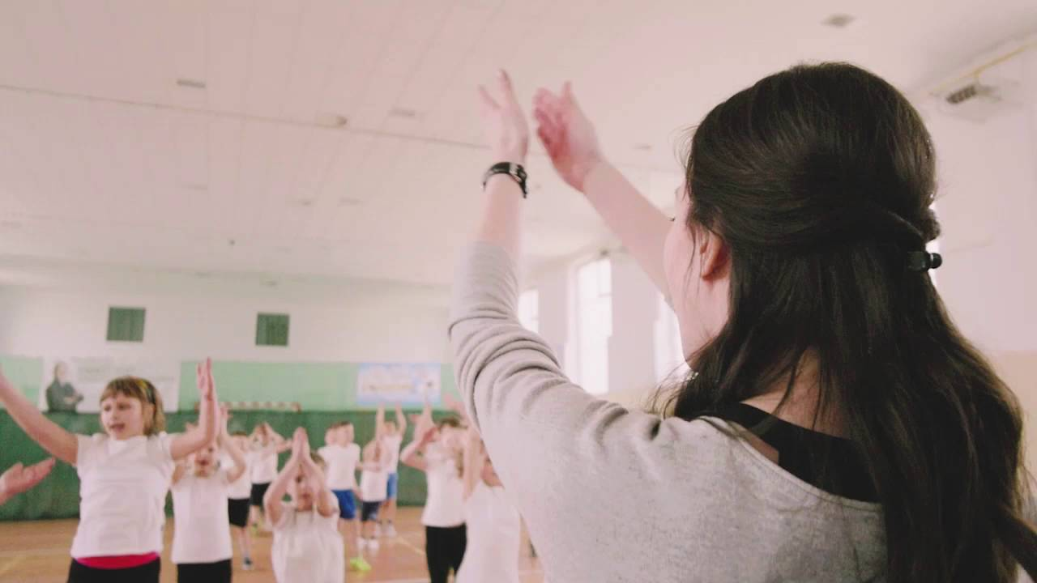
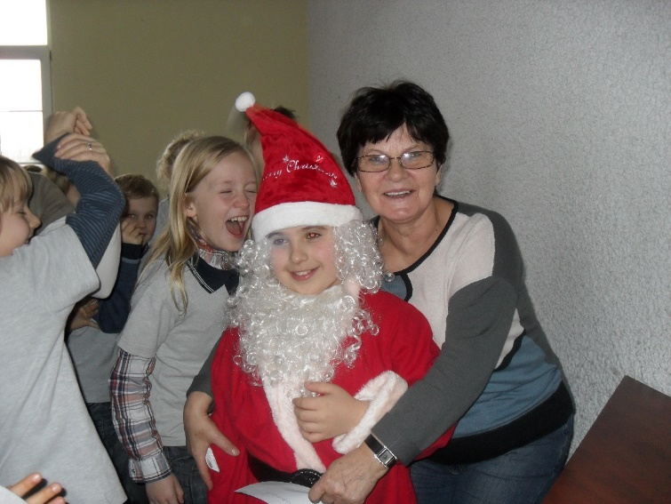
We mainly rely on the teachers who attract pupils and their parents by putting into practice innovative methods and creating their own programs. The main responsibility of our highly qualified teachers is to assist a student in exploring the world and to motivate a child to achieve success.

Slide 7
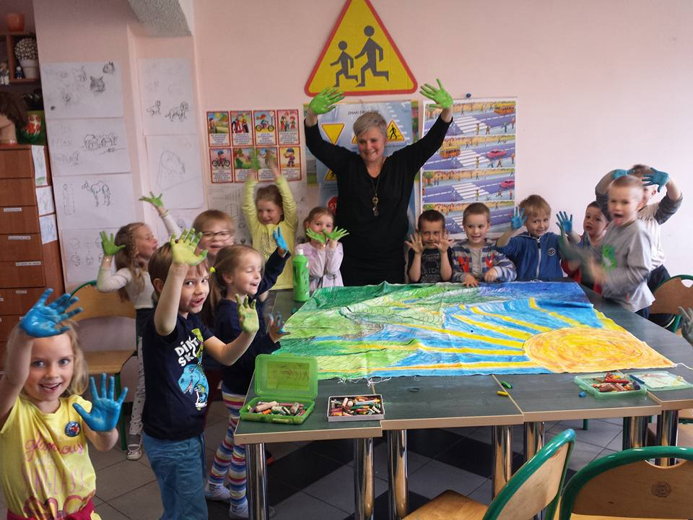
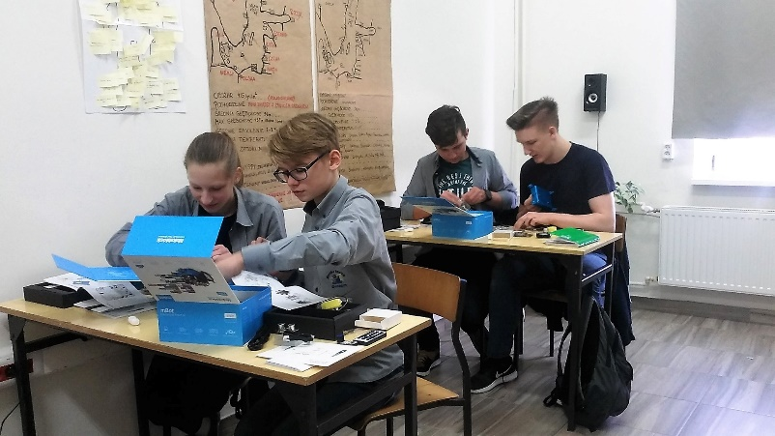
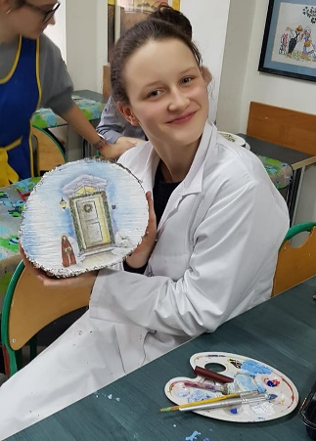
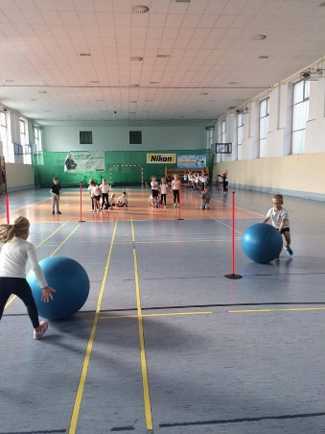
CLUBS
Besides following the obligatory national curriculum, our school provides the students with various clubs to develop their passions and interests.
Among other things we offer extra classes with English native speaker, chess, art workshops, dance or sports clubs.

Slide 8
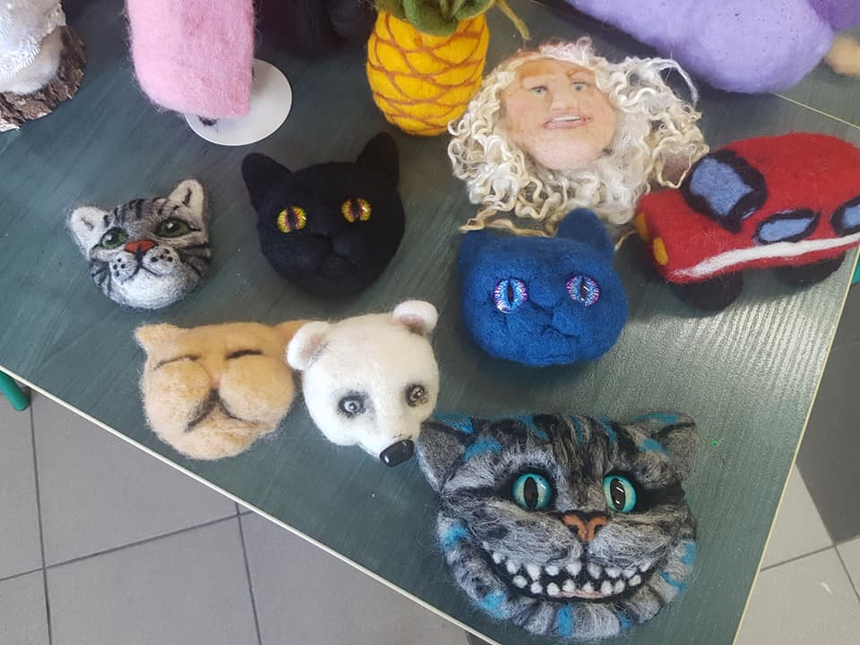
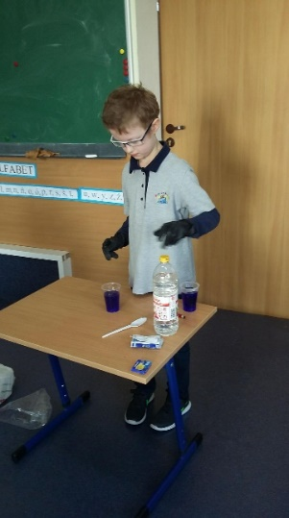
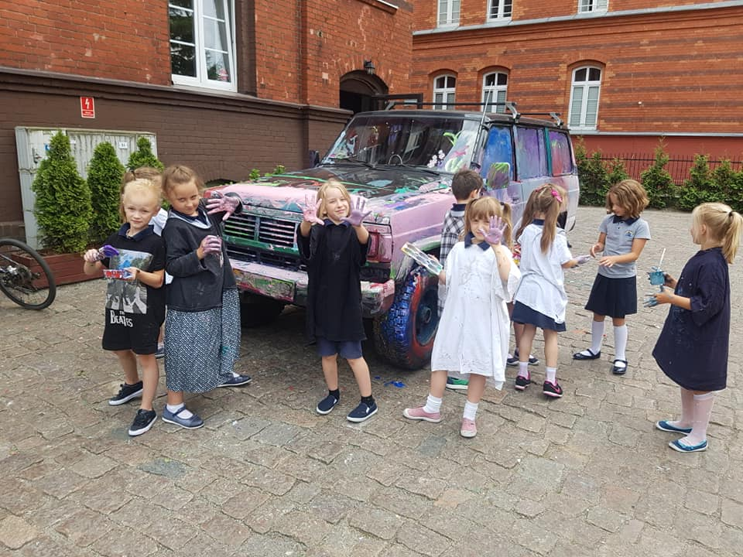
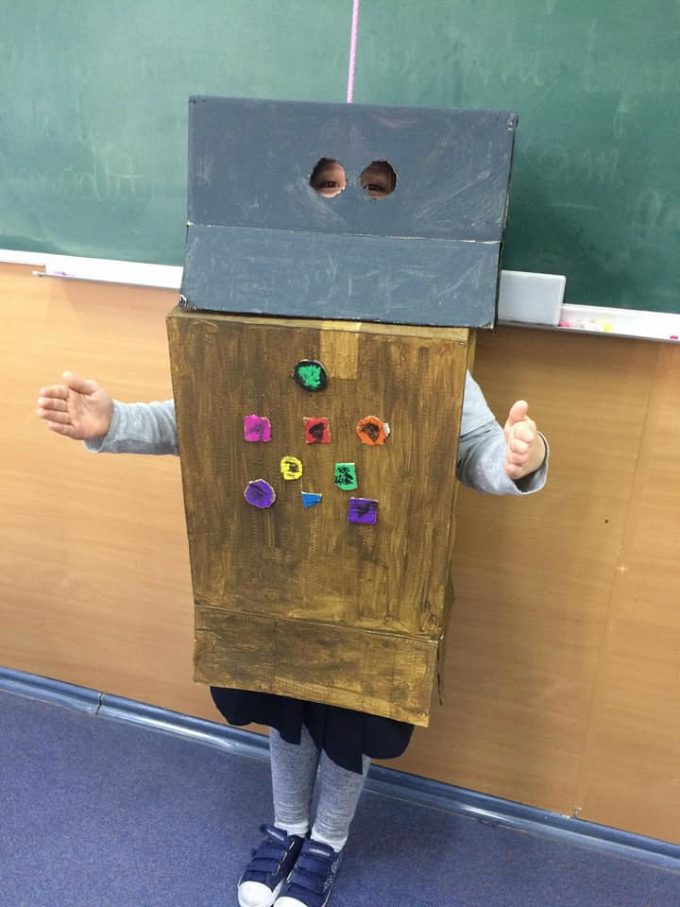

Chess puzzle
Chemical experiments
Wonders of felt
Creative costiumes
Creative painting☺

Slide 9
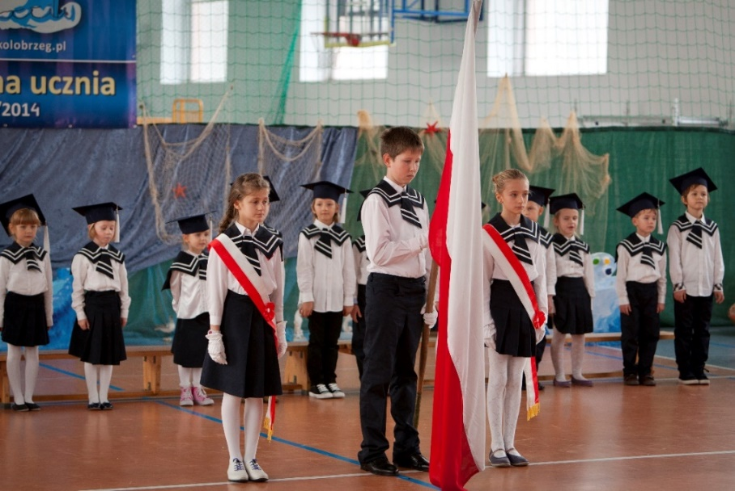
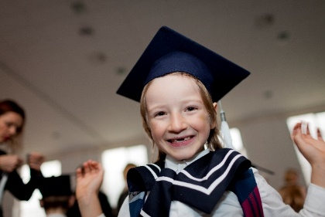
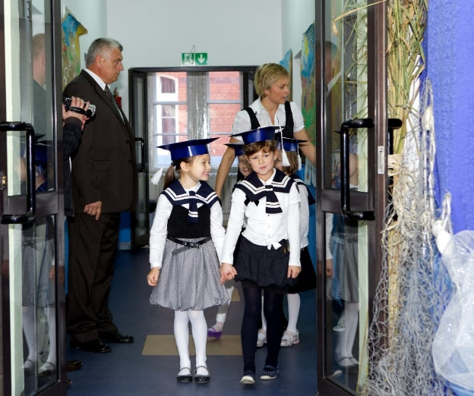
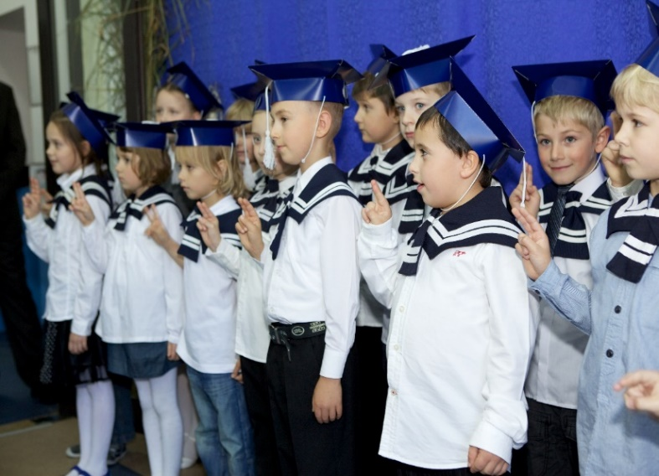
OUR STUDENTS
School is a wide area of new exciting experiences both for children and their parents.
Every begining of new school year is thrilling, exciting and full of expectations.
The first and one of the most memorable moments in every pupil’s life is certainly the celebration of becoming a student of „Morska Kraina”.
We do our best to make this day a fantastic begining of school adventure and gifts obtained while the celebration are to recall about a new stage in students’ life.

Slide 10

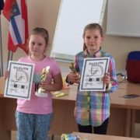
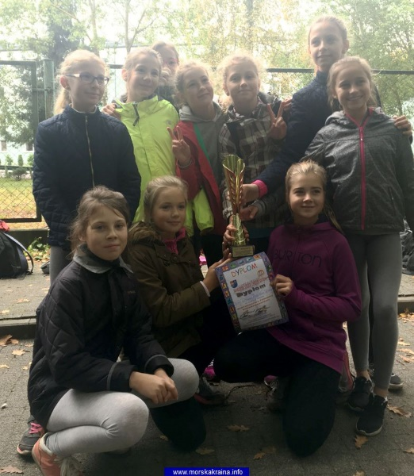
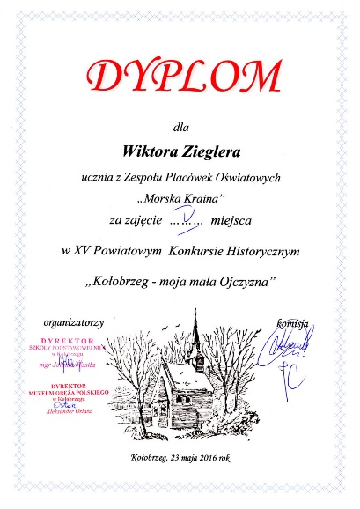
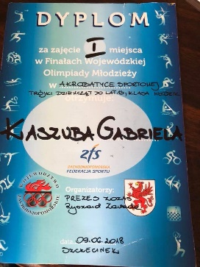
OUR STUDENTS’ SUCCESSES
They are our biggest satisfaction and joy!
The students of „Morska Kraina” are prizewinners of many competitions of high levels in our country as well as international ones, like KANGUR or FOX.
They take part in various tournaments including sports, singing, reciting, drawing, writing and those which check particular knowledge (ex.history, languages, geography).

Slide 11
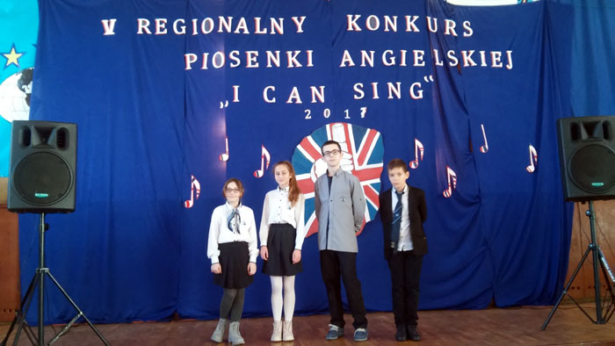
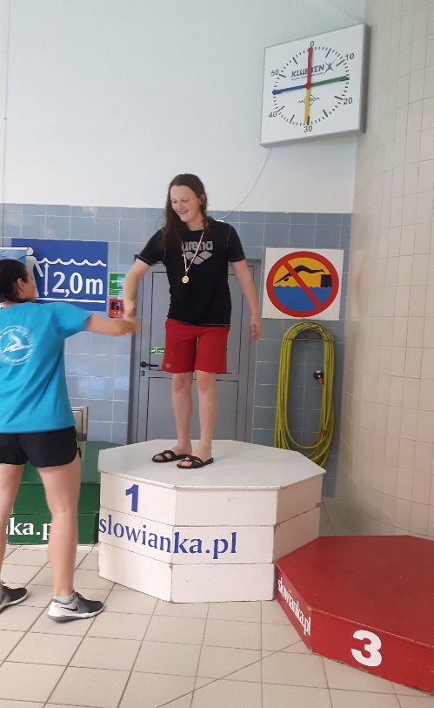
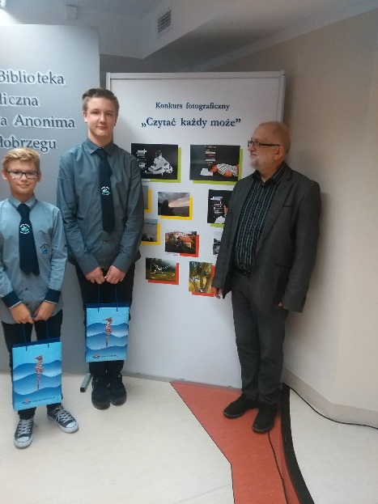
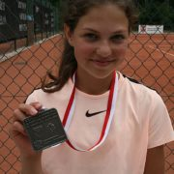
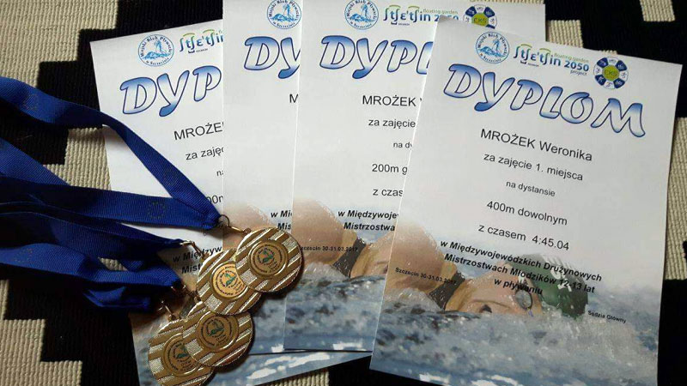
Every year, for their achievements, our students are awarded by the president of Kołobrzeg.
We do remember that their success is the result of priceless ability to reconcil hard work with passion and education every single day.
So… we do not have choice but we have to be proud of them, and of course we ARE!

Slide 12
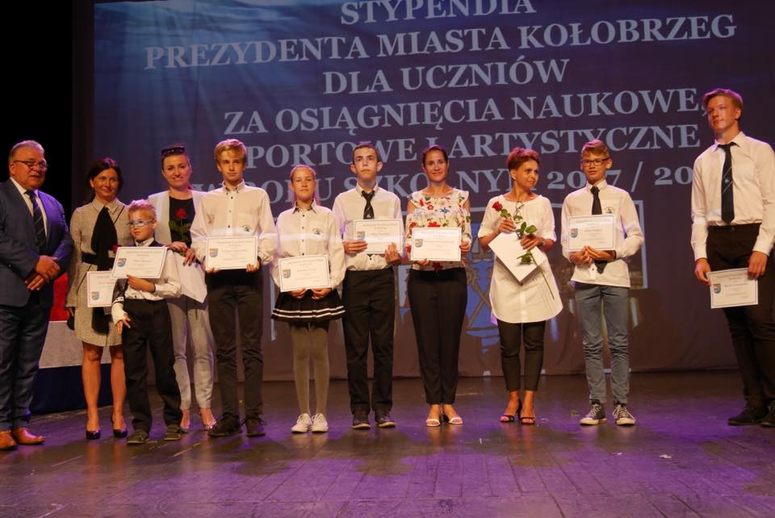
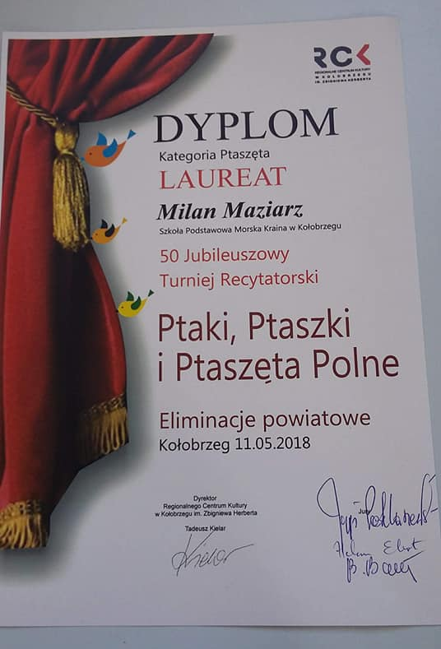
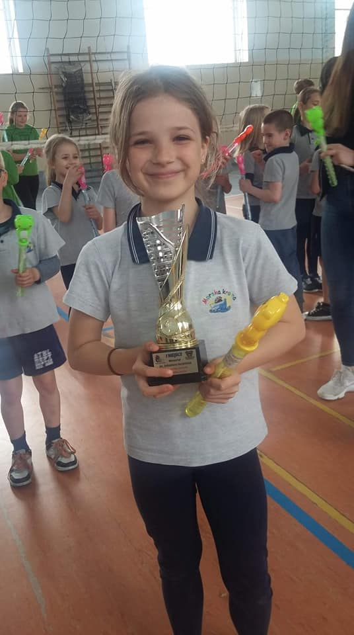

Slide 13
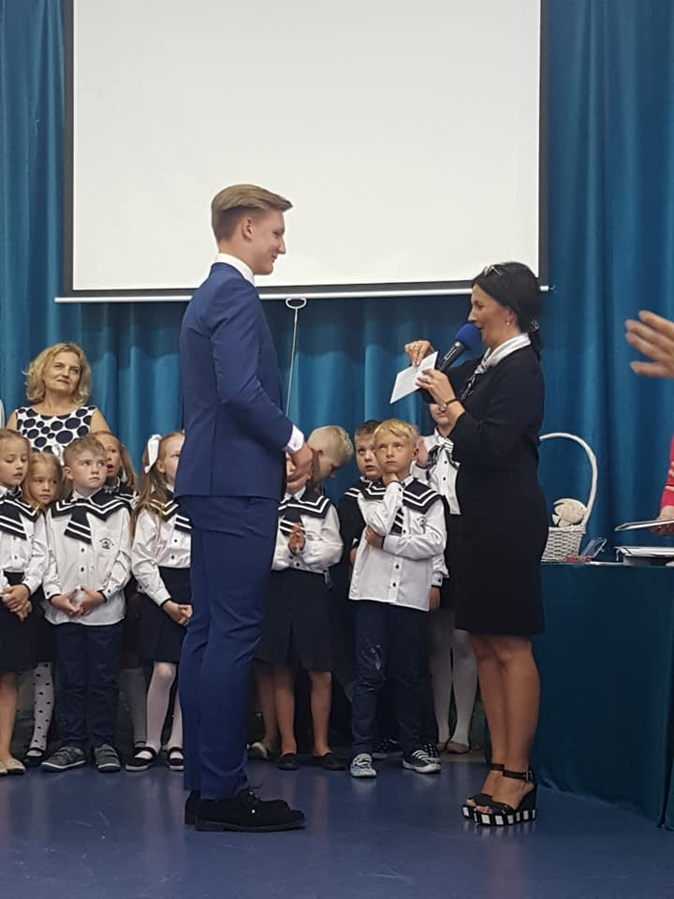
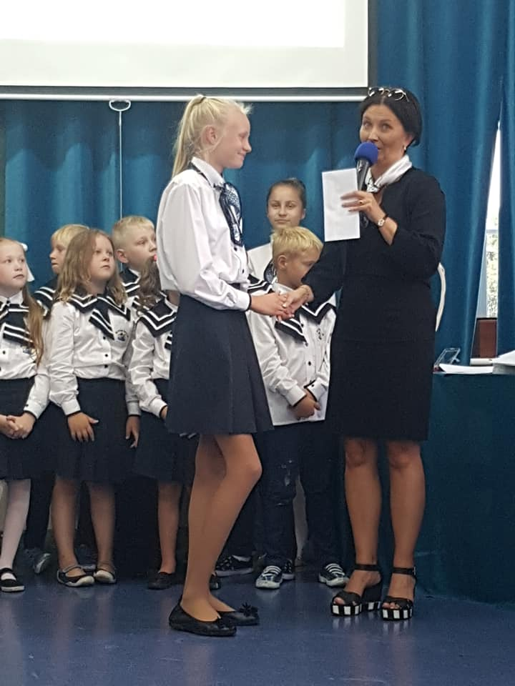

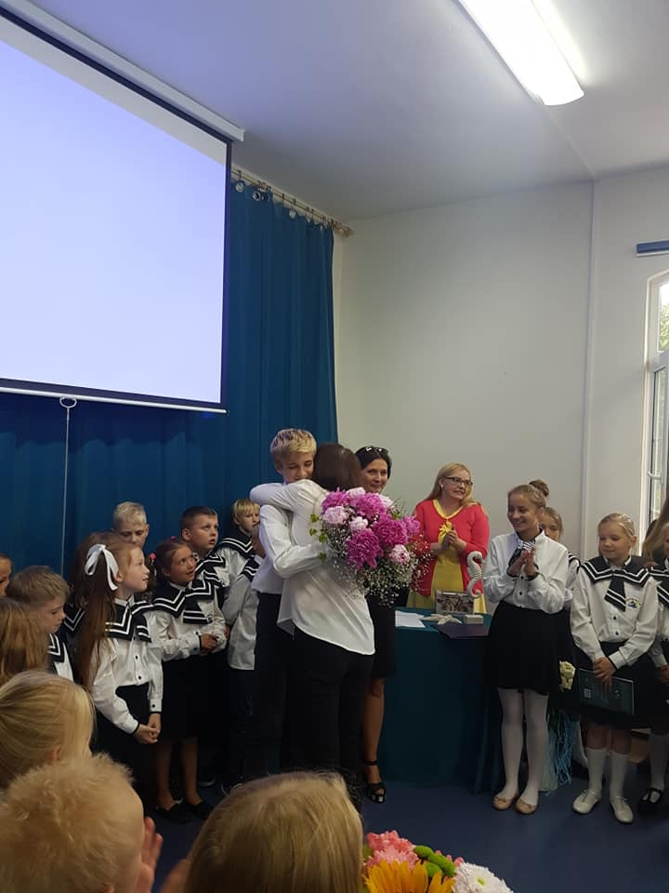
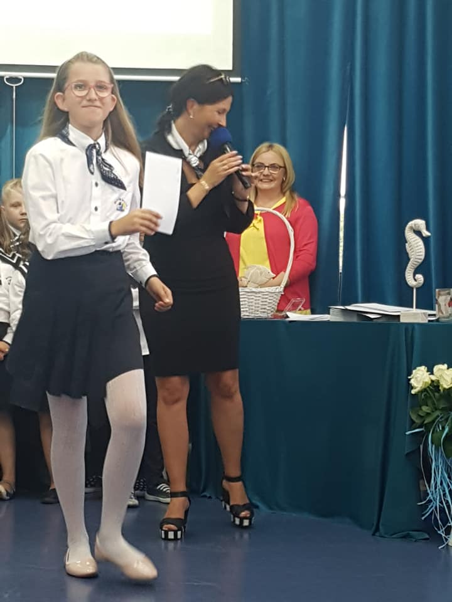
We, as a school itself, also support our students – every year our Fundation Integration of Educational Environments „Morska Kraina” awards the most harworking talented ones.
It can accur thanks to support of every single benefactor.
Giving a scholarship not only do we take into account students’ talents and hard work but we also hold to traditional values of good manners, pride in appearance, respect, responsibility and the development of self-discipline.

Slide 14
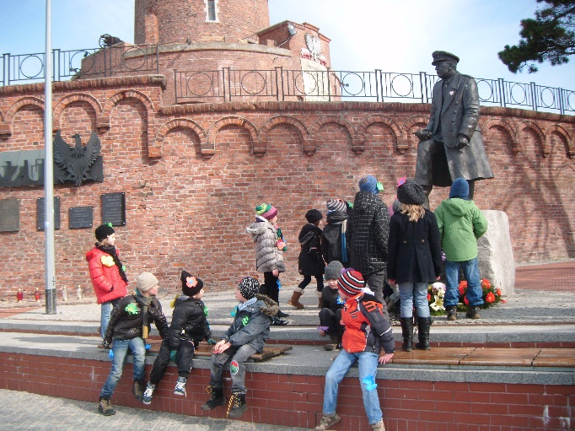
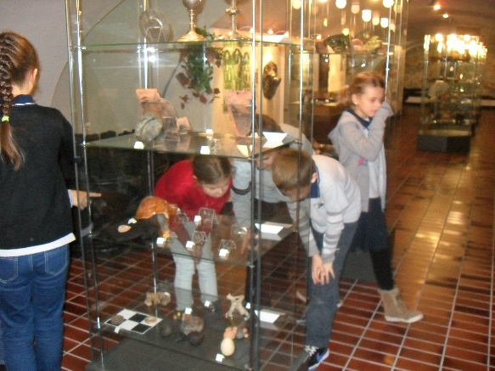
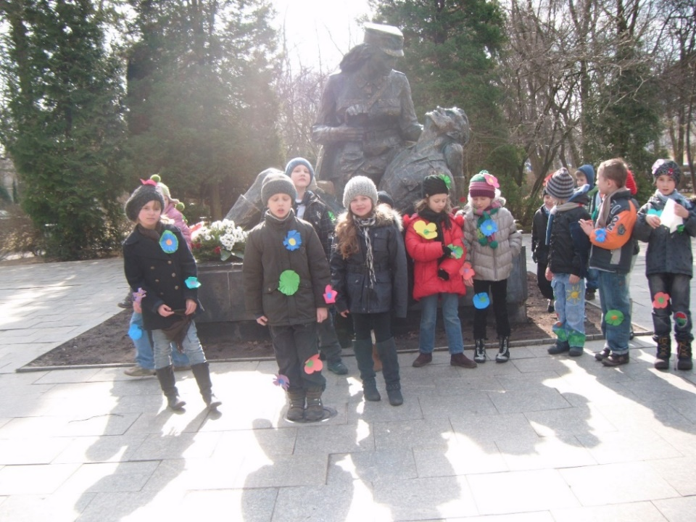
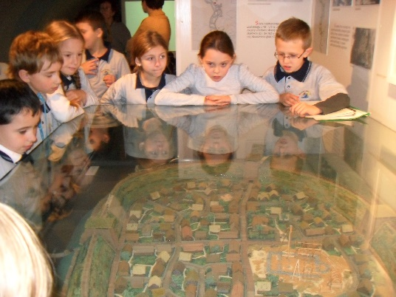
OUR EVERYDAY LIFE…
Studying in „Morska Kraina” does not only mean a classroom!
The main factor is certainly outdoor education, including excursions, visits to the theatre or cinema, lessons in museums, exploring the neigbourhood or meeting with interesting people.
Throughout the year all children go on a variety of trips which enhance the curriculum.
These can be whole school trips or class specific trips.
We follow the most efficient methods with plenty of exploration, observation and experience.

Slide 15
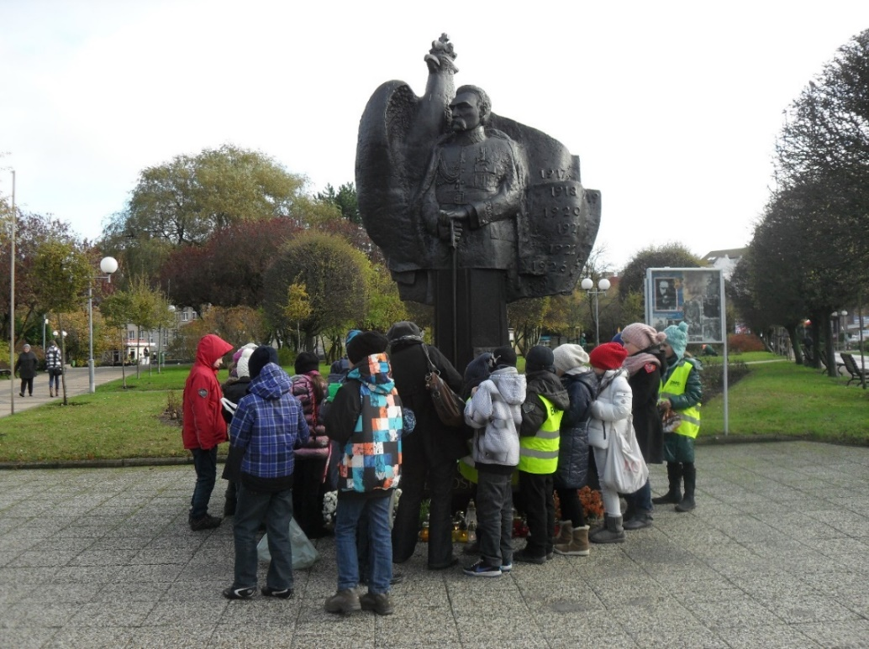
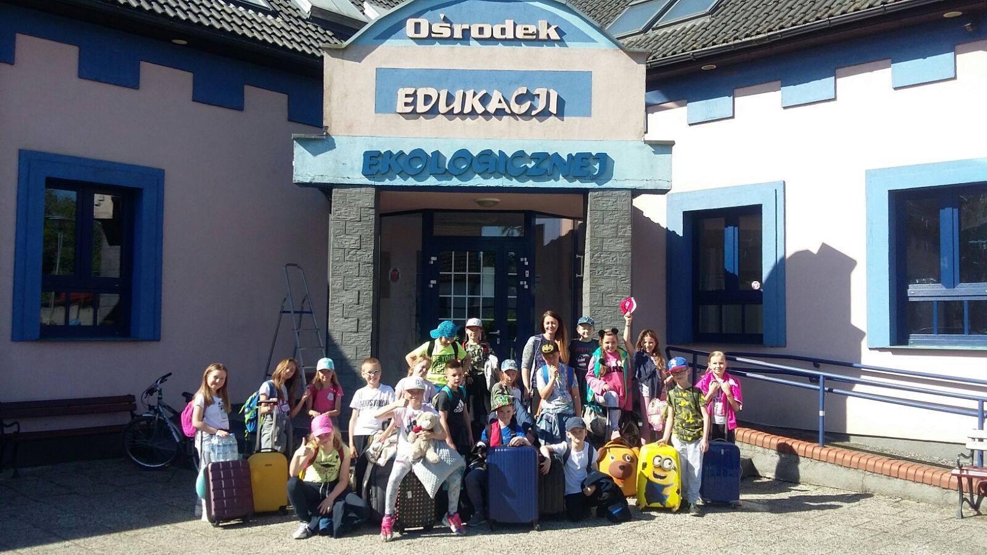

…SCHOOL TRIPS
VISITING
DISCOVERING
EXPLORING

Slide 16




PARTICIPATING IN INTERNATIONAL PROJECTS
Our institution eagerly collaborates with other schools and takes part in innovative educational programs or school projects.
Our pupils take part in school exchanges, international language projects, innovative educational platforms, as well as visit different countries and institutions abroad. Everything just to broaden their minds.

Slide 17



LEARNING WITH FUN AND JOY
We strongly believe that the most appropriate way of learning and acquiring knowledge or skills accurs while playing and having fun.
Education combined with fun?
In „Morska Kraina” we are trying to put into practice as many such projects as possible!
Not mention language or historical dramas, competitions, English and German songs, dancing performances, games… All in all, every day brings new ideas for all of us!
☺

Slide 18



Performance in German
Creative costiumes
Akademia Pana Kleksa

Slide 19




SUPPORTING VOLUNTARY
Our students are eager to support voluntary events in Kołobrzeg and our country.
We believe that the amount of goodness and gold heart given to the other person returns with doubled strength.
Respect to the others and disinterested help are the most priceless values we are trying to pass on every day.
Help brings joy – just have a look ☺

Slide 20





Slide 21


Meetings with experts
Nothing works as well and impresses kids as well as possibility to confront their life experience with real and highly qualified people’s example.
„Morska Kraina” is often visited by many interesting and extraordinary guests.
We invite experts of education, artists, doctors, policemen, firemen and many other people of different proffesions.
Every single meeting is held to develop imagination and broaden the students knowledge by learning about the secrets of presented jobs and special tools or equipment.

Slide 22





Slide 23


Meeting and cooperating with experts of education –
prof. E. Gruszczyk-Kolczyńska,
mgr E. Zielińska
„Morska Kraina” initiates and puts into practice many programs. One of them is the program of profesor Edyta Gruszczyk-Kolczyńska, the icon of contemporary pedagogy and teaching mathematics in early childchood.

Slide 24



The main effect of collaboration with prof. Gruszczyk –Kolczyńska became numerous methodological workshops for the whole staff carried out by her co-worker and co-author of significant studies - mgr Ewa Zielińska.

Slide 25




Our successes
Permanent development of our institution is the first goal for us. We eagerly take part in competitions and innovative programs which help us discover various ways of education and constantly widen our offer.

Slide 26






Slide 27





CELEBRATING GALAS
Talents should not be hidden!
Every year our institution organises solemn galas on the stage of Regional Centre of Culture in Kołobrzeg. During these events our students present their talents and achievements, which are the effects of their yearlong work.
Aplause, parents’ emotions, joy and amasing pictures – every year we enlarge our collection of incredible memoirs!

Slide 28






Slide 29







Slide 30

What will you find in our school?
Family, warm atmosphere
Dedicated, well-qualified and friendly staff
Innovative programs, methods and forms of education
Constant development and achieving goals
Learning by games, observation, experience, experiments and fascinating projects
Unic opportunity to get used to public performance for every single student from the very begining of education
Cooperation: pupil-school-home
Interesting trips and meetings with experts
Plenty of outdoor activities
Scholarships for the best
Following the main values: respect, friendship, good manners, suport and trust
Teaching by encouraging and creative attitude
Extra classes and clubs as a chance to develop passions and interests
Support for bilingual, returning from abroad kids with poor Polish language in use
…and loads of other amasing issues! ☺

Slide 31






Friendship

Slide 32







Play

Slide 33





Integration

Slide 34






Learning

Slide 35

Thank you for your attention☺

